Slide 1
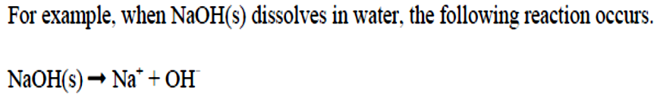
Lectures 7
Dr. Mohammed Abdul Baset
Acids and Bases
"Acid”--Latin word acidus, meaning sour. (Lemon)
"Alkali”--Arabic word for the ashes that come from burning certain plants; water solutions feel slippery and taste bitter. (Soap)
• Lavoisier’s oxygen theory of acids
The first scientific concept of acids and bases was provided by Lavoisier circa 1776. Since Lavoisier's knowledge of strong acids was mainly restricted to oxoacids, such as HNO₃ (nitric acid) and H2SO4 (sulphuric acid), which tend to contain central atoms in high oxidation states surrounded by oxygen. The Lavoisier definition was held as absolute truth for over 30 years, until the 1810 article and subsequent lectures by Sir Humphry Davy in which he proved the lack of oxygen in H₂S, H₂Te, and the hydrohalic acids.
• Liebig’s hydrogen theory of acids
This definition was proposed by Justus von Liebig circa 1838, based on his extensive works on the chemical composition of organic acids. This finished the doctrinal shift from oxygen-based acids to hydrogen-based acids, started by Davy. According to Liebig, an acid is a hydrogen-containing substance in which the hydrogen could be replaced by a metal.
• Arrhenius Acids and Bases theory
In 1884 Svante Arrhenius suggested that salts such as NaCl dissociate when they dissolve in water to give particles he called ions.
Acid: donates a hydrogen ion (H+) in water.
Base: donates a hydroxide ion in water (OH⁻).
37

Slide 2
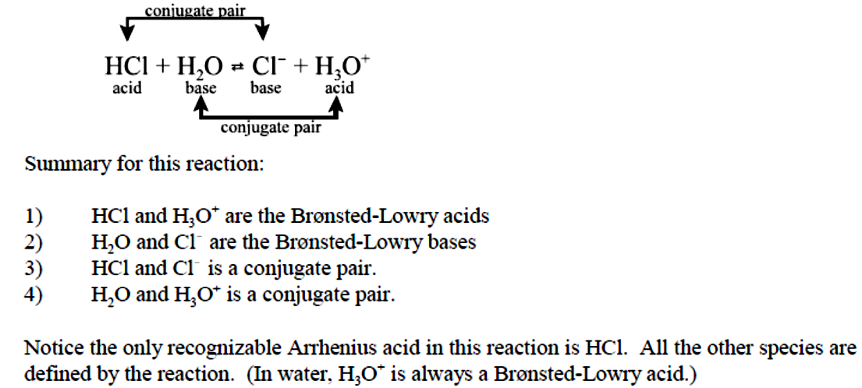
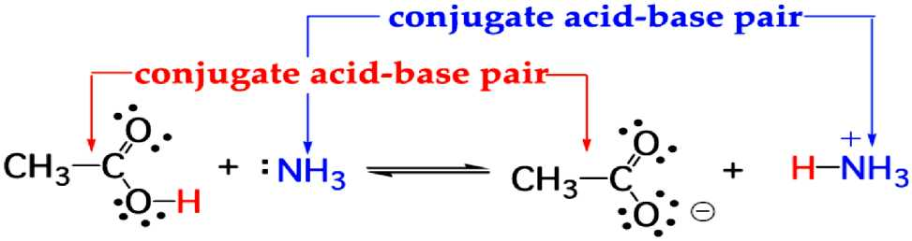
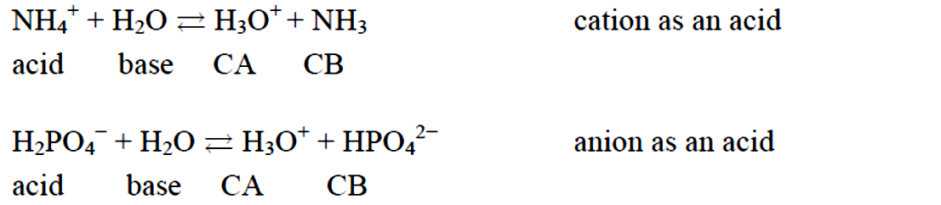
For example, for HCl dissolved in water, the following reaction exists.
Notice HCl is an acid because it transfers its proton to water, HCL and Cl⁻ differ by an H+ and H2O and H3O+ differ by an H+. These are call conjugate acid-base pairs. HCl is the conjugate of Cl⁻ and H2O is the conjugate of H3O+. This is illustrated as follows:
Conjugate acid-base pair--A pair of compounds that differ by the presence of one H+ unit. Examples:
This theory is better; it explains ammonia as a base! This is the main theory that use for explain acid/base discussion.
• Lewis Acid-Base theory
Acid: accepts an electron pair for the formation of a compound or a complex ion. Base: donates an electron pair for the formation of a compound or a complex ion.
38

Slide 3
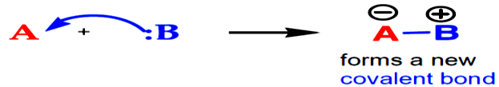
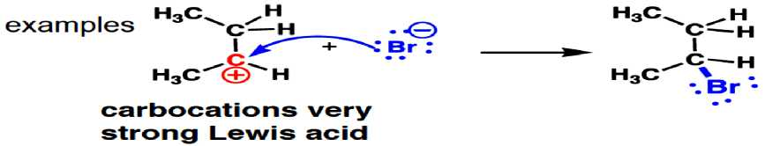
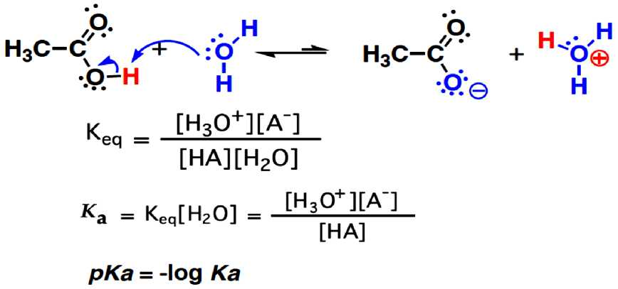
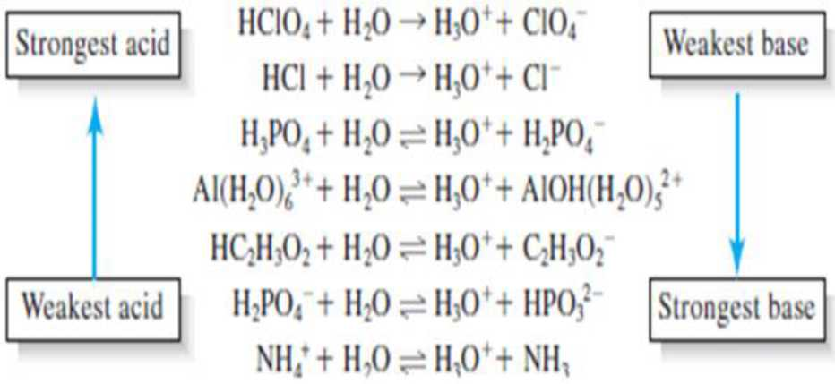
This theory explains all traditional acids and bases plus a host of coordination compounds and is used widely in organic chemistry. All Bronsted/Lowry acids are Lewis acids, not all Lewis acids are Bronsted acids.
1) Strengths of Acids and Bases
How is acid [base] strength expressed/compared? By equilibrium constant
e.g.: dissociation (ionization) of acetic acid
39

Slide 4
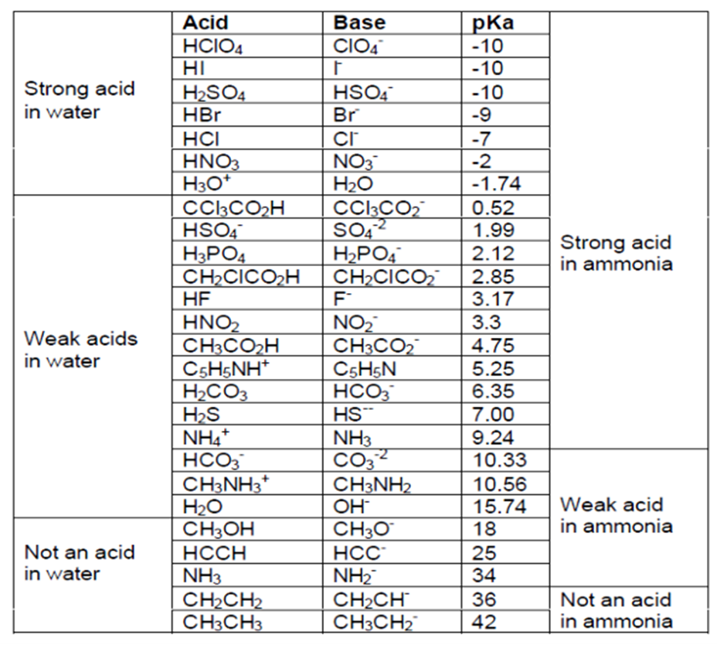
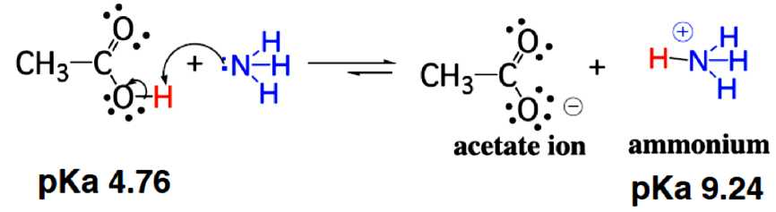
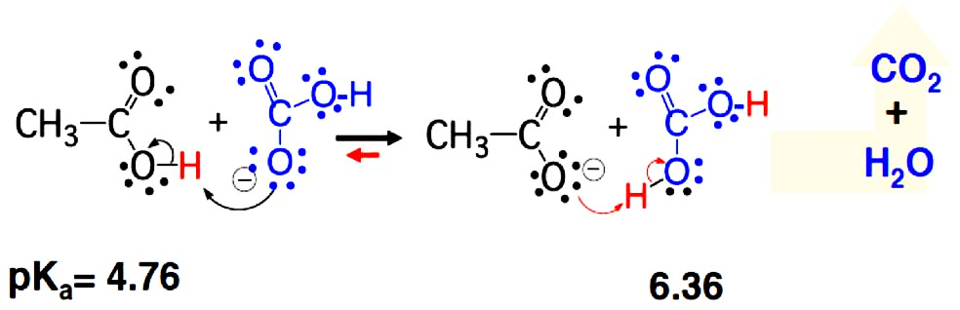
2) Acid-Base Equilibria
Strong acid - completely to product(s)
Weak acid - incomplete, gives an Equilibrium direction favors reaction of stronger acid-base pair
Acetic acid + sodium bicarbonate (omit Na⁺)
40

Slide 5
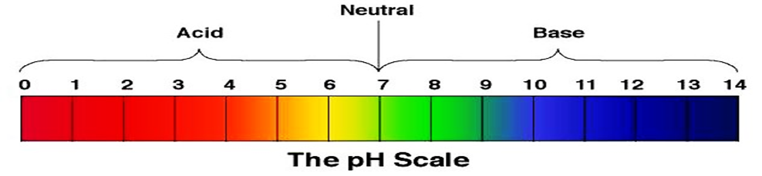
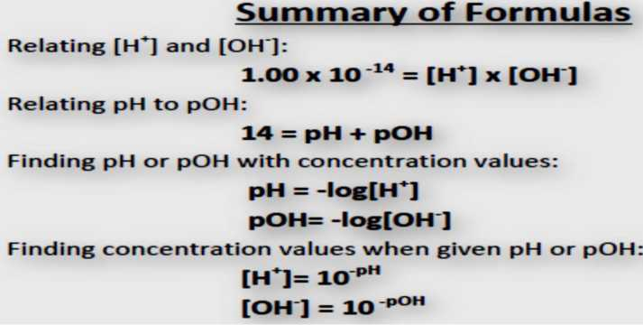
pH, pOH and Kw calculation
pH is the measurement of the hydrogen ion concentration, [H+]. Every aqueous solution can be measured to determine its pH value. This value ranges from 0 to 14 pH. Values below 7 pH exhibit acidic properties. Values above 7 pH exhibit basic properties. Since 7 pH is the center of the measurement scale, it is neither acidic nor basic and is, therefore, called "neutral."
Also, pH is defined as the negative logarithm of the hydrogen ion concentration. It is expressed mathematically as:
pH = -log [H⁺]
where: [H+] is hydrogen ion concentration in mol/L
In a neutral solution, the [H+] = 1 x 10⁻⁷ mol/L. This represents a pH of 7.
pH = -log (1 x 10⁻⁷)
= -(log 1 + log 10⁻⁷) = -(0.0 + (-7)) = 7.0
When determining the pH of a solution, the hydroxide ion concentration can be calculated:
[H+][OH⁻] = 10⁻¹⁴
The pOH scale
Base concentrations:
pOH = -log10[OH⁻]
A neutral solution (25°C) has:
pOH = -log10[1.0 x 10⁻⁷] = -(-7.00) = 7.00
Since Kw = [ H3O+][OH⁻] = 1.0 x 10⁻¹⁴
-log(^)= -log[H3O+] + (-log[OH⁻]) = -log(1.0 x 10⁻¹⁴)
pK^ = pH + pOH = 14.00
41

Slide 6
42

Slide 7
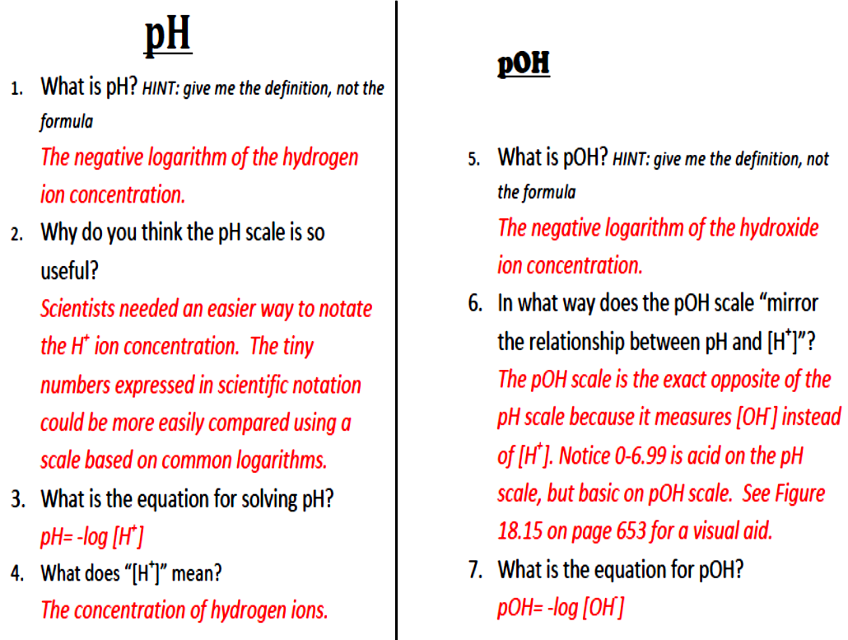
43

